Slide 1
IN THE NAME OF GOD
Evidence – Based Medicine

Slide 2

What do you think about EBM?

Slide 3
Minimum reading to keep up-to-date with pediatrics
Pediatrics – 40 articles x 12 months
New England Journal of Medicine – 5 articles x 52 weeks
Lancet - 6 articles x 52 weeks
Journal of Pediatrics – 18 articles x 12 months
Pediatric Infectious Disease Journal - 15 articles x 12 months
JAMA 8 articles x 12 months
BMJ 10 articles x 52 months
Archives of Pediatric and Adolescent Medicine – 10 articles x 12 months
1694 article per year= 5 articles per day

Slide 4
HISTORY
MIDDEL 19 CENTURY IN FRANCE MEDICAL SCHOOL
EBM WAS CREATED M.C MASTER UNIVERSITY 1980
It was initially proposed by Dr. David Sackett and colleagues at McMasters University in Ontario, Canada.

Slide 5
What is Evidence-Based Medicine?
Evidence-based medicine (EBM) is an important change in the way physicians practice, teach, and do research.

Slide 6
DEFINITION
INTEGRATION OF CLINICAL EXPERIENCE WITH THE BEST EVIDENCE PROVIDED BY SYSTEMATIC AND OBJECTIVE – ORIENTED RESEARCH
EBM MODEL
BEST EVIDENCE
Patient
values
Clinical
expertise

Slide 7
The Evolution of EBP 2002, Haynes et al
Clinical State
& Circumstances
Clinical Expertise
Patient Preferences
& Actions
Best Research
Evidence

Slide 8
DEFINITION
CONSCIENTIOUS,EXPLICIT &JUDICIOUS USE OF CURRENT BEST EVIDENCE IN MAKING DECISIONS ABOUT CARE OF INDIVIDUAL PATIENTS OR THE DELIVERY OF HEALTH SERVICES ^{DAVID SACKETT}.

Slide 9
EBM OBJECTIVES
KEEPING YOUR SKILLS UP TO DATE
-MEMORY DECREASE
-NEW TREATMENT METHODS
SAVING TIME
SAVING LIVES
SUPPLEMENTING CLINICAL JUDGEMENT(EBM MODEL)

Slide 10
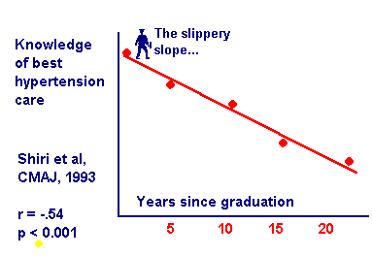

Slide 11
مزاياي EBM
قابل آموزش به پزشكان در سطوح مختلف
پر كردن شكاف بين تحقيقات باليني و بكارگيري نتايج آنها
تقويت آ‌موزش مستقل و خود محور
تقويت بحث گروهي
روز آمد كردن اطلاعات پزشكان
درك عميق روش تحقيق توسط متخصصين باليني

Slide 12
مزاياي EBM
افزايش اعتماد به نفس پزشكان باليني در اخذ تصميم باليني
افزايش توانائي پزشكان در جستجوي اطلاعات
عادت به مطالعه را در پزشكان مي افزايد
امكان توجيه منطقي تصميمات درماني را براي بيماران فراهم مي كند.
طراحي دستور العمل مشترك براي تصميمات باليني توسط متخصصين محلي

Slide 13
مضرات EBM
آموزش و بكارگيري EBM در بالين وقت گير است
هزينه فراهم سازي امكانات زياد است
كاهش اعتماد به نفس پزشكان در مقابل اطلاعات جديد و اقدامات فعلي آنها

Slide 14
EBM Method
Assess
your patient
Ask clinical
questions
Acquire the
best evidence
Appraise
the evidence
Apply
evidence to
patient care
Notes:
Alternative to next slide

Slide 15
EBM PROCESS
PATIENT PROBLEM
CLINICAL QUESTION
SEARCH FOR EVIDENCE
CRITICAL APPRAISAL OF THE EVIDENCE
APPLYING THE RESULTS INTO PRACTICE (CURRENT PATIENT)

Slide 16
Evidence-based Practice
Ask
Assess
Acquire
Apply
Appraise

Slide 17
The Practice of EBM
Step 1: Asking an answerable question
Step 2: Tracking down the best evidence to answer that question
Step 3: Critically appraise the evidence for validity, size of the effect, and utility of the findings
Step 4: Incorporate the clinical appraisal into our clinical expertise and patient’s individual issues
Step 5: Evaluate and improve steps 1-4 with each new opportunity to apply these principles

Slide 18
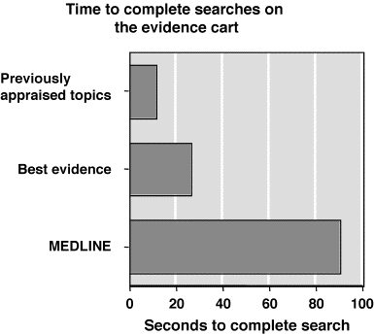
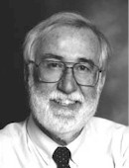
Evidence Cart
Dave Sackett

Slide 19
Domains of EBM
TREATMENT
PROGNOSIS
DIAGNOSIS
ETIOLOGY/CAUSATION/HARM

Slide 20
Types of Clinical Questions
By Content
By Format
Diagnosis
Therapy
Etiology
Prognosis
Background
Foreground

Slide 21
Good clinical questions
“Background” Questions
General knowledge
Two components
Root (who, what, when, where, why)
A disorder or aspect of a disorder
E.g., “What is the typical age of onset of bipolar disorder?”
“How do I decide to use a typical vs. atypical antipsychotic for agitation?”

Slide 22
Good clinical questions
“Foreground” Questions
These ask for specific information about managing a patient with a disorder
They have 3-4 essential components

Slide 23
FORMULATING CLINICAL QUESTION(well built Question)
In daily practice,there is 1 question per 4 patients
Direct observation by ^{covell DG,et al.} ^{Ann} ^{Int Med 1985;103:596-9}
Revealed :
2 questions per 3 patients
15 questions per shift
2/3 of questions left unanswered

Slide 24
COMPONENTS OF CLINICAL QUESTIONS
P - patient and population (problem)
I - intervention(treatment,test,prognosis…)
C - comparison
O - outcome

Slide 25
Diagnosis
“In patients with suspected pulmonary fibrosis, how does high-resolution CT compare with lung biopsy for establishing the diagnosis?”
P = Pulmonary fibrosis
I = High-resolution CT
C = Lung biopsy
O = Sensitivity/specificity/PVs/LRs

Slide 26
Etiology
“Do obstetrical complications during pregnancy increase the likelihood of schizophrenia in the child?”
P = Pregnant females
I = Obstetrical complications
C = No obstetrical complications
O = Childhood schizophrenia

Slide 27
Prognosis
“In patients with acute leukemia, is a normal white cell count at the time of diagnosis an independent predictor of disease-free survival?”
P = Acute leukemia
I = Normal white cell count
C = Abnormal white cell count
O = Disease-free survival

Slide 28
Ask Clinical Questions
Components of Clinical Questions
Patient/
Population
Intervention/
Exposure
Comparison
Outcome
In patients with
acute MI
does early treat-
ment with a statin
compared to
placebo
decrease cardio-
vascular mortality?
In women with
suspected
coronary disease
what is the
accuracy of
exercise ECHO
compared to
exercise
ECG
for diagnosing
significant
CAD?
In post-
menopausal
women
does hormone
replacement
therapy
compared to no
HRaT
increase the
risk of
breast cancer?

Slide 29
Clinical question(scenario) for treatment
P –in a child with frequent febrile seizures
I – would anticonvulsant therapy
C – compared to no treatment
O – results in seizure reduction

Slide 30
Question for diagnosis
P – in an otherwise healthy 15 yrs old boy with sore throat
I- how does the clinical exam
C- compare to throat culture
O- In diagnosing GAS infection ?

Slide 31
Question Prognosis
P- In children with Down syndrome
I - Is IQ an important prognostic factor
C
O - In predicting Alzheimer’s later in life

Slide 32
Etiology/Harm
P -controlling for confounding factors, do otherwise healthy children
I -exposed in utero to cocaine
C - compared to children not exposed
O - have increased incidence of learning disabilities at age six years?

Slide 33
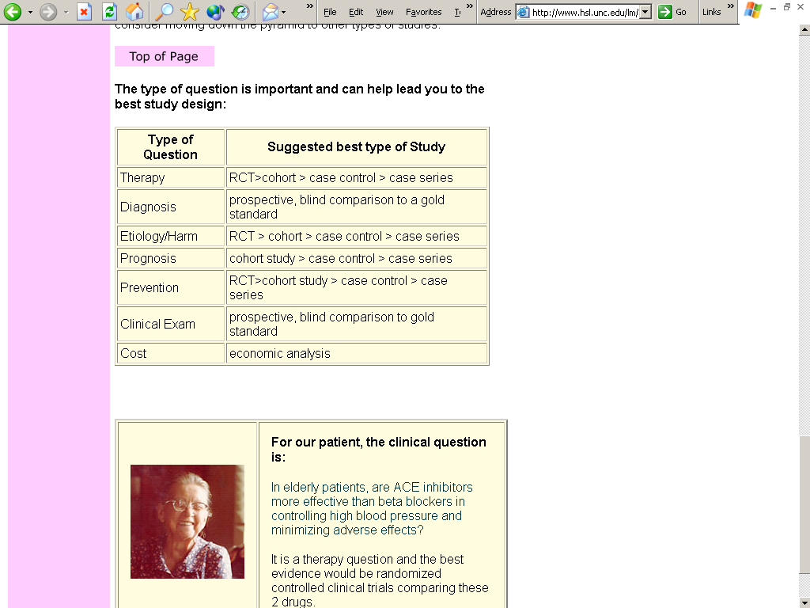

Slide 34
THANK YOU
ANY QUESTIONS?

Slide 35
EBM Method
Assess
your patient
Ask clinical
questions
Acquire the
best evidence
Appraise
the evidence
Apply
evidence to
patient care
Notes:
Alternative to next slide

Slide 36
How to Learn About Best Information Resources?
From librarians (hands-on training)
From experts in medical informatics
Courses/ Tutorials

Slide 37
Searching for Answers: The “4S” Approach of Haynes Haynes RB: EBMH 2001;4:47 and ACP Journal Club 2001;134:A11
Systems (comprehensive resources)
Clinical Evidence (www.clinicalevidence.com)
Collection of evidence-based guidelines
Synopses (structured abstracts)
Evidence-Based Mental Health (http://ebmh.bmjjournals.com/)
ACP Journal Club (www.acpjc.org)
Syntheses (systematic reviews)
Cochrane Database (OVID)
DARE (http://agatha.york.ac.uk/darehp.htm)
Studies (original research)

Slide 38
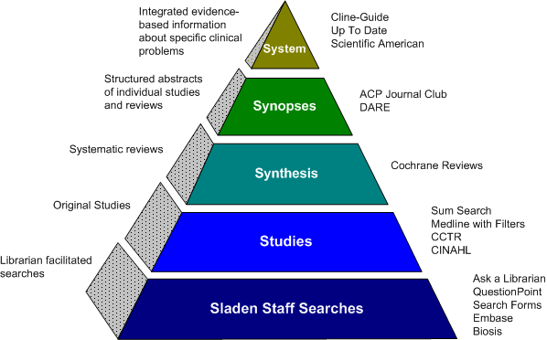

Slide 39
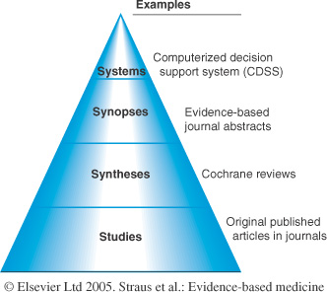
Ideal, still theoretical, links EMR to best research evidence, always updated, drills down
Provide enough information to support a clinical action
More details, summaries based on exhaustive search for evidence, explicit scientific reviews, and systematic assembly of evidence
When all above fails, more recent or not reviewed topics

Slide 40
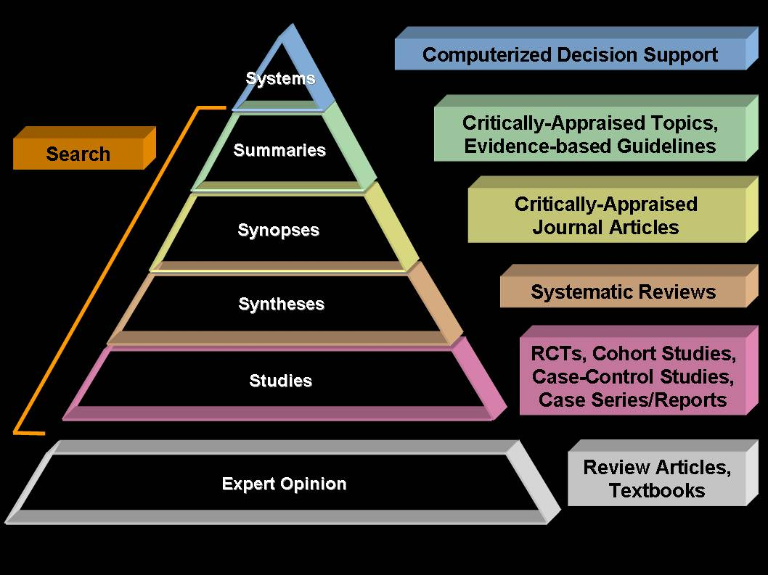
EBM hierarchy Haynes 5S pyramid

Slide 41
Systems
Clinical Evidence (BMJ)
URL: http://www.clinicalevidence.com
Contains limited range of clinical questions
PIER (the Physician’s Information and Education Resource) by ACP
URL: http://pier.acponline.org
Only for members
UpToDate®
URL: http://www.uptodate.com
Updated quarterly
Extensively referenced
ACP Medicine (Formerly Scientific American Medicine)
URL: http://www.acpmedicine.com

Slide 42
Systems (Cont’ed)
Harrison’s Principles of Internal Medicine
URL: http://www.harrisonsmed.com
Only updated every 3 years
Evidence Based on Call
URL: http://www.eboncall.org/content.jsp.htm
Evidence-Based Pediatrics and Child Health
URL: http://www.evidbasedpediatrics.com
Evidence Based Cardiology
URL: http://www.evidencebasedcardiology.com/
OVID includes and links EBMR (Cochrane, ACP Journal Club, the Database of Abstracts of Reviews of Evidence (DARE), and Medline

Slide 43
Criteria to evaluate systems
Look for Systems that:
Are revised at least once a year: Date of revision should be listed
Select and appraise the evidence in an explicit way (Introduction)
Site evidence to support clinical care declarations

Slide 44
Synopses
Published in secondary journals
Select only high-quality original research and review articles
Use explicit quality criteria for selection
Appraise for validity
Prepare structured, “value-added” abstract
Accompanying commentary
Declarative title that gives “bottom line”

Slide 45
Synopses
ACP Journal Club http://www.acpjc.org/
Give you the summary and links you to the evidence
Ex: “Low Molecular Weight Heparin is Effective and Safe in the Acute Coronary Syndromes”

Slide 46
Syntheses: Systematic Reviews
What makes a review systematic?
Comprehensive search
Use only high-quality studies
Summarize results
Sources of systematic reviews
Cochrane Library (available through OVID)
Database of Abstracts of Systematic Reviews (DARE): http://agatha.york.ac.uk/darehp.htm

Slide 47
Syntheses
Cochrane Library
URL: http://www.cochranelibrary.com/
OVID’s EBMR
(Includes ACP Journal Club, Cochrane Database of Systematic Reviews (CDSR), and DARE)

Slide 48
Studies
Specialized
ACP Journal Club: www.acpjc.org
Evidence Based Medicine: www.ebm.bmjjournals.com
Evidence Based Nursing: www.ebn.bmjjournals.com
Evidence Based Mental Health: www.ebmh.bmjjournals.com
General
Cochrane Central Register of Controlled Trials (Therapy)
MEDLINE: http://www.ncbi.nlm.nih.gov/PubMed/
Using the Clinical Queries Search
ASK MEDLINE http://askmedline.nlm.nih.gov/ask/ask.php
Make use of your Library and Institutional subscriptions

Slide 49
Textbooks are only useful for “background questions” (Pathophysiology of clinical problems)

Slide 50
Alternatives to the “4S” Search Approach
TRIP database (www.tripdatabase.com)
Searches Cochrane, DARE, collections of systematic reviews and guidelines, and some on-line journals
Links to PubMed clinical queries
SUMSearch (http://sumsearch.uthsca.edu)
Searches MEDLINE, DARE, National Guidelines Clearinghouse
Takes longer than TRIP

Slide 51
EBM Method
Assess
your patient
Ask clinical
questions
Appraise
the evidence
Acquire the
best evidence
Apply
evidence to
patient care
Notes:
Alternative to next slide

